Slide 1



Sitecore 10 Certification Crash-Course Stoneman to Superman
60 minutes

Slide 2
Table of Contents
Master vs Web DB Data Templates Template Inheritance Insert options Standard Values Field Editor Button Use Presentation Details - Layout - Controls - Placeholder Settings Dynamic Placeholder Static vs Dynamic Component Binding Sitecore MVC Concepts - Layout - View Rendering Sitecore Rendering properties Visual Studio Publish vs Sitecore Publish Versioned Layouts Site Definition Patch Config Sharing Content between Sites Config File Load Order Layers.config Sitecore Support Package Sitecore Security Domains Sitecore.IdentityServer.Host.xml
User Manager Role Manager Security - Users/Groups Workflow Elements of Workflow Workbox Sitecore ASP.NET Core Rendering Host Sitecore Headless Service Sitecore ASP.NET Rendering SDK Startup.cs functionality Service Registration in Startup.cs Sitecore CLI Plugin Setup Sitecore CLI - sitecore.json Sitecore CLI - module.json Sitecore CLI vs Sitecore for Visual Studio Sitecore Docker Lifecycle .env file General Tips

Slide 3
Sitecore Exam Competencies
50 questions, 2 hrs
Online-proctored; need a separate camera, laptop camera won’t suffice
Mark for review option
Check for Sitecore Partner coupon with employer for exam discount
https://navansitecorenotes.blogspot.com/2022/02/sitecore-10-exam-competencies.html

Slide 4
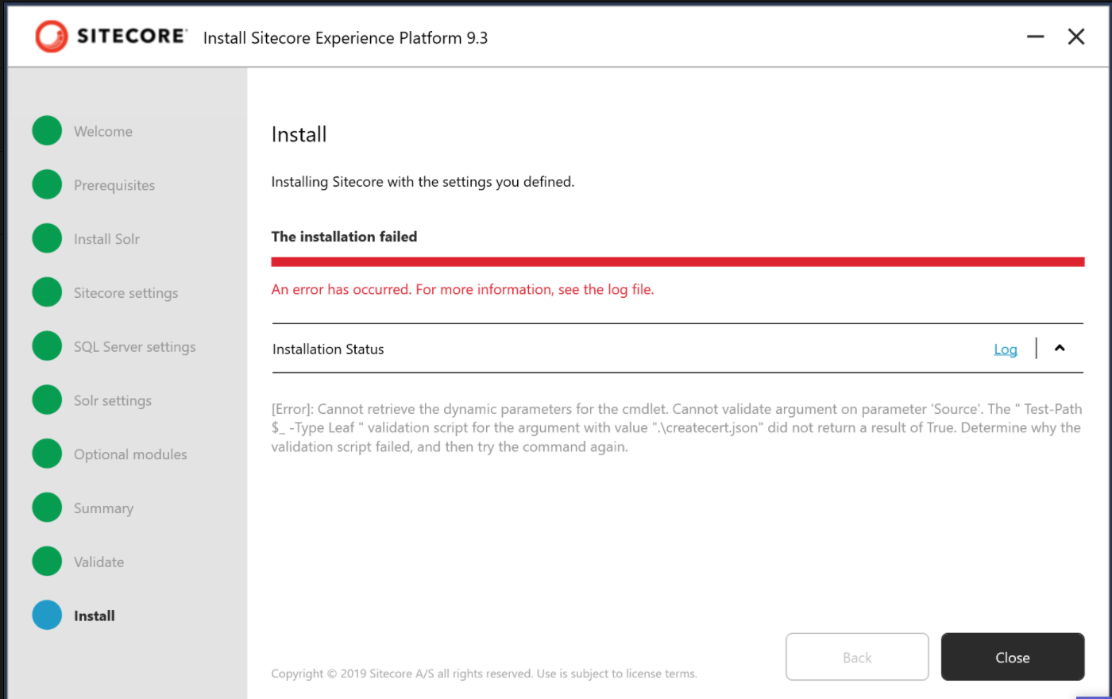
SIA Installation Errors
Missing Certificates Folder:

Slide 5
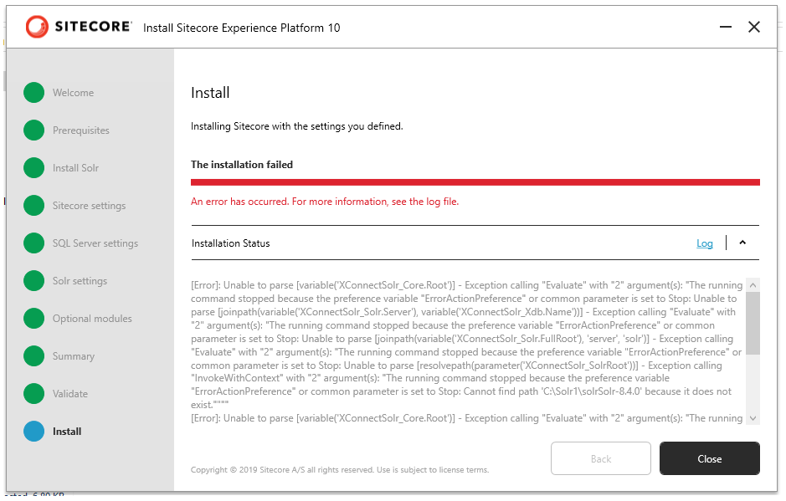
SIA Installation Errors
Non-existent Solr Path:

Slide 6





Master vs Web DB
C
O
N
T
E
N
T
E
D
I
T
O
R
S
L
I
V
E
U
S
E
R
S
Master
Web
Publish
Unpublished Content
Published Content

Slide 7
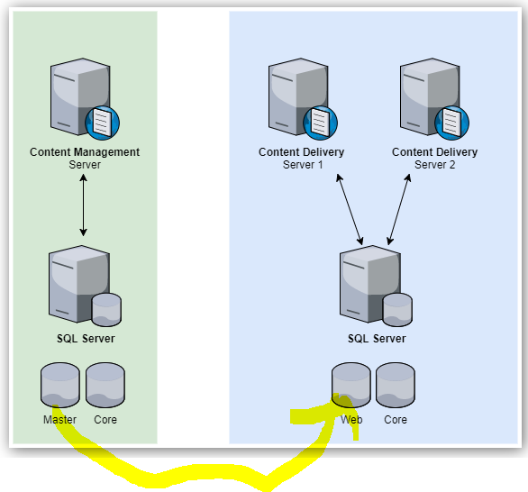
Master vs Web DB
Master DB to edit content while Web DB is used to store live data
Content changes made in Web DB will be overwritten by next publish so, always changes must go from master -> web
Publishing Wizard:
Content Editor
Experience Editor
Sitecore Desktop

Slide 8
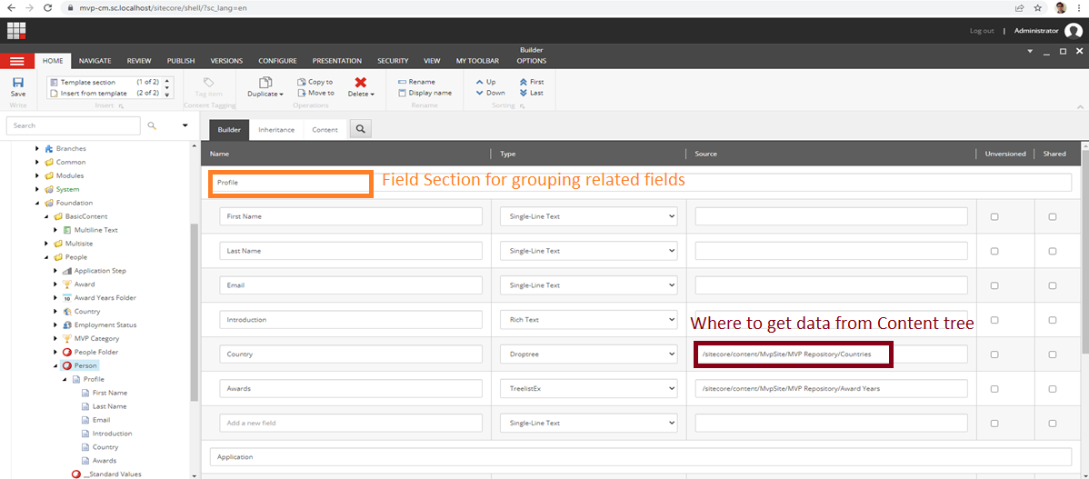
Templates or Data templates
Nothing but data structures
When you select types like multilist / droptree / treelist, you must set the source too

Slide 9
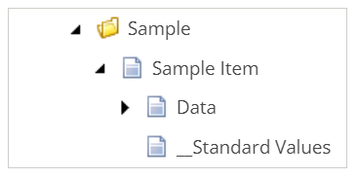
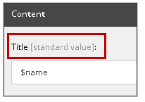
Standard Values
Default value for field
Fallback value when field value is null
Good practice to setup Presentation Details since it standardizes content creation process
Tokens:
$name: The name of the item
$id: The ID of the item
$parentid: The ID of the parent item
$parentname: The name of the parent item
$date: The system date (yyyyMMdd)
$time: The system time (HHmmss)
$now: The date and time (yyyyMMddTHHmmss)
https://doc.sitecore.com/xp/en/developers/100/sitecore-experience-manager/standard-values.html

Slide 10
Template Inheritance
Title
- Description
Component
Blurb
CTA
Image
Score
Reviewer
Date of Review
Banner
Author
Copyright
Publish Date
Rating
Article
Note: If a field with same name across two templates points to two different source, then it is not a candidate for inheritance

Slide 11
Sitecore MVC Concepts
Layout:
Sitecore
Visual Studio
Layout Definition Item
Layout File (.cshtml)
View Rendering:
Sitecore
Visual Studio
Rendering Definition Item
View File (.cshtml)

Slide 12
Sitecore MVC Concepts
Sitecore Context
Layout Details
Layout Definition
Rendering (.cshtml)
Layout (.cshtml)
Placeholder Definition
Placeholder
Template Field
Rendering Definition
Data Source
Placeholder
Template Field
Placeholder Definition
Rendering Definition
Data Source
Template Field
Placeholder
Placeholder Definition
Rendering Definition
Data Source
Template Field

Slide 13
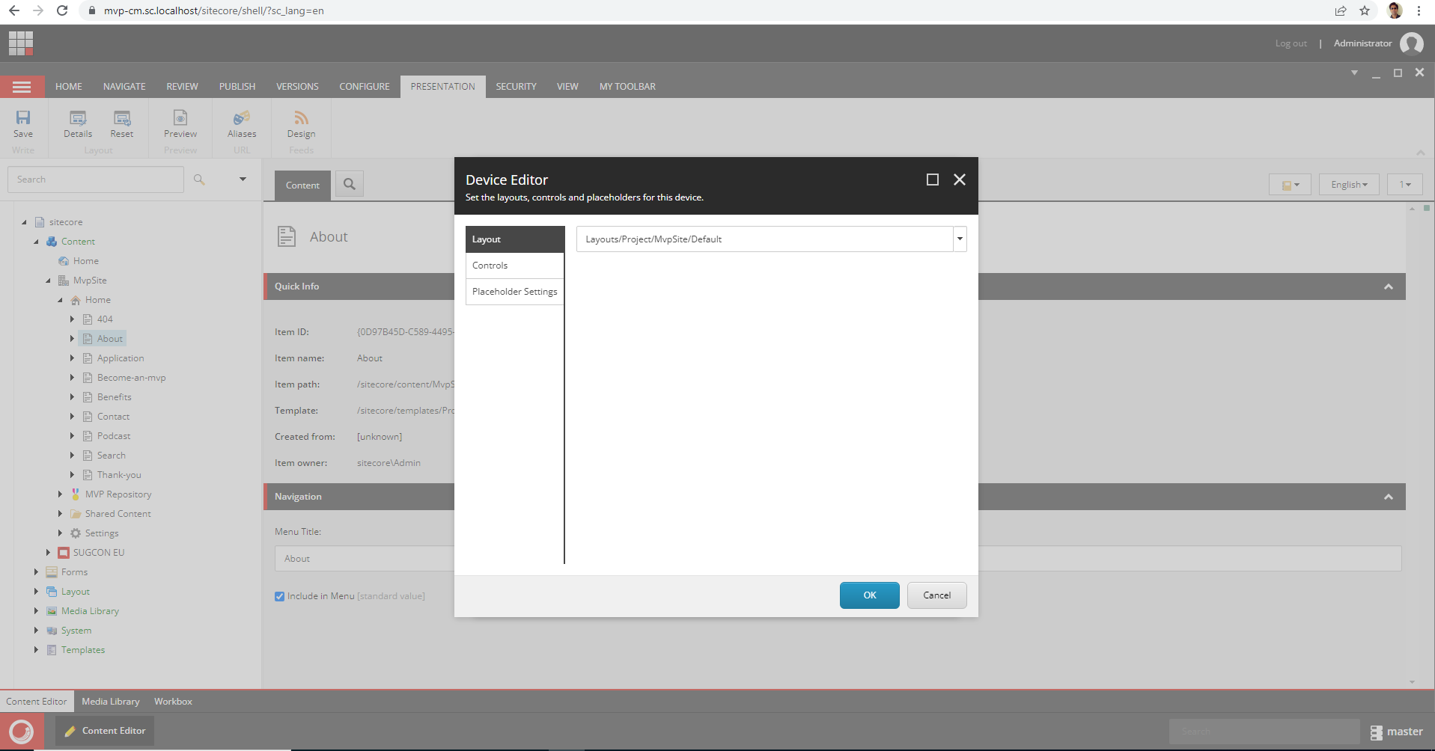
Presentation Details
For page to be visible,
the following are important:
Layout
Controls

Slide 14
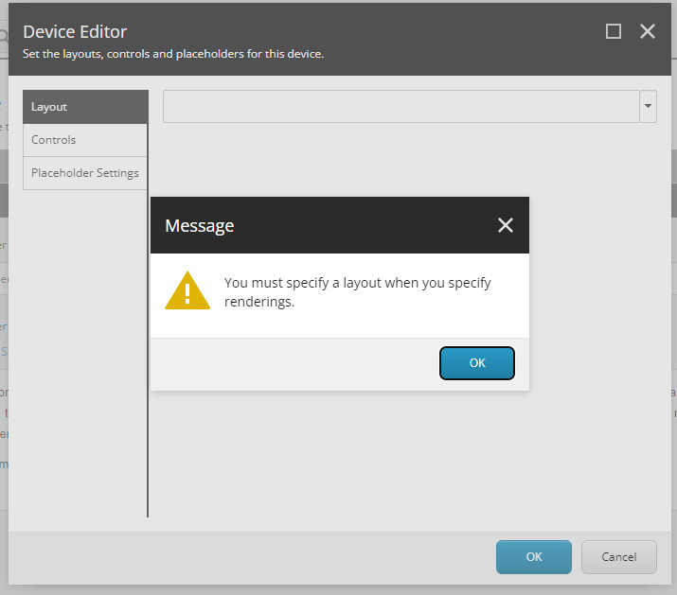
Presentation Details
Layout mandatory for Presentation Details with controls:

Slide 15
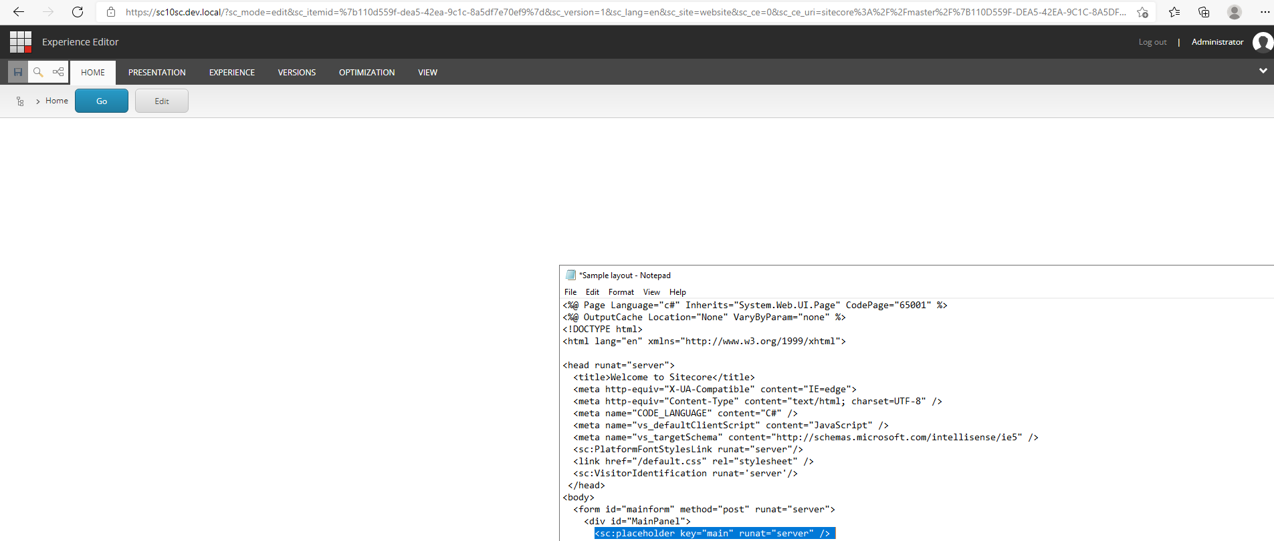
Presentation Details
Removing “main” placeholder in cshtml does not display the rendering within:

Slide 16
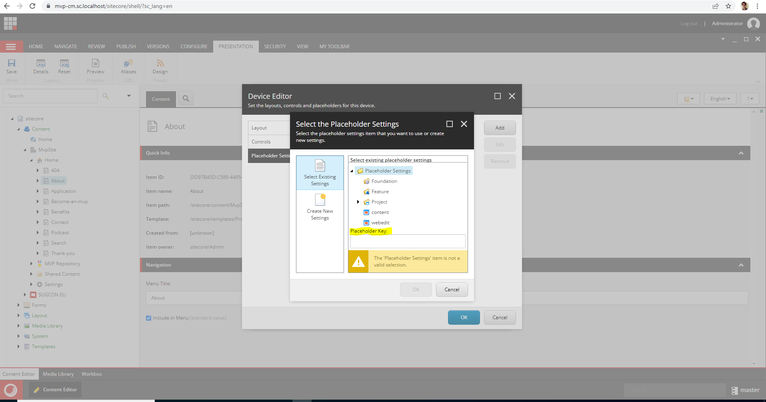
Presentation Details
Placeholder is uniquely identified by Placeholder key

Slide 17
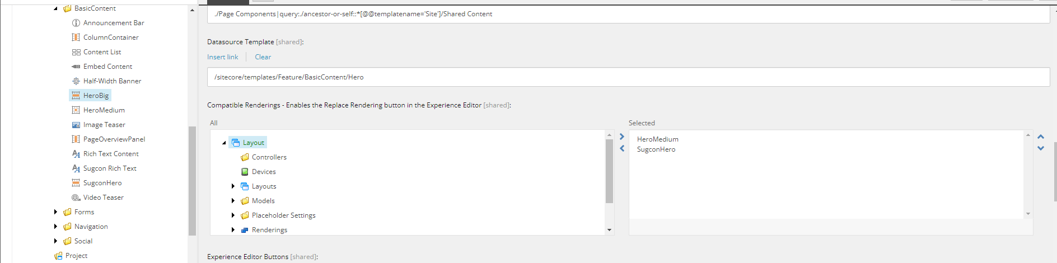
Rendering
Checkbox or tree list cannot be rendered using @Html.Sitecore.Field()
A Compatible Rendering is a component that can be replaced with another component providing both use the same data source type (or no data source at all) e.g. use the same type of data.
https://mattneil.co.uk/2017/01/17/compatible-renderings-in-sitecore/
https://community.sitecore.com/community?id=community_question&sys_id=64a4e7ed1b0770d0b8954371b24bcbb0#14463

Slide 18
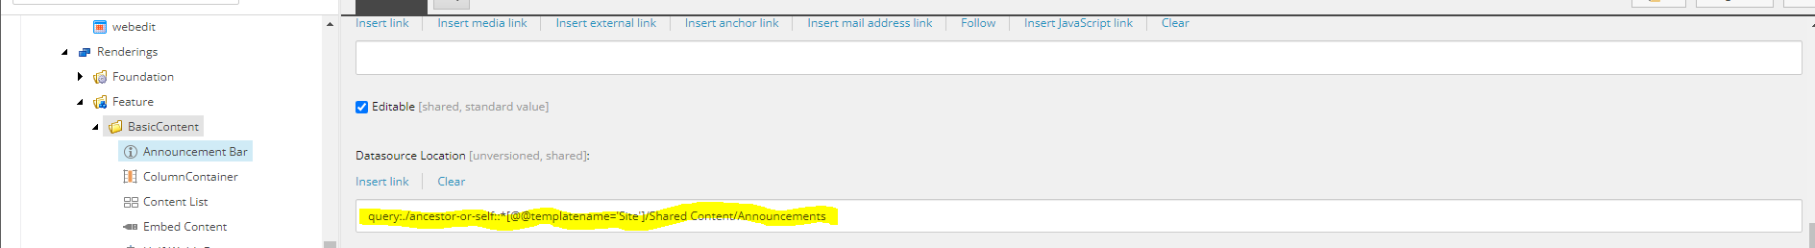
General Sitecore MVC titbits
Dynamic component binding useful in personalization
Static component binding useful for fixed header or footer and disallows content editors to remove the component
Configure rendering Datasource location to restrict content editors to select content from a specific location in the content tree
Configure Datasource template to filter content items based on a template
https://www.jondjones.com/learn-sitecore-cms/sitecore-developers-guide/sitecore-and-mvc/how-to-make-sitecore-use-a-mvc-controller-controller-renderings-explained/

Slide 19
Insert Options
Good practice to setup insert options on standard values of an item template
You can set insert options on an item in the content tree as well
The former allows inserting only specific type of items while the latter option is useful when you want to add additional items
https://doc.sitecore.com/xp/en/developers/91/sitecore-experience-manager/insert-options.html#:~:text=Sitecore%20administrators%20and%20developers%20configure,the%20user%20could%20possibly%20insert.

Slide 20
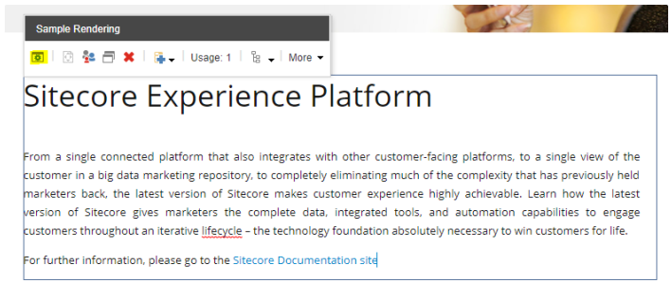
Field Editor Button
Field Editor Buttons allow you to enhance the user experience for a given component. There maybe some field options that are not available in Experience Editor and you have to edit the content via the Content Editor. This overall is not a good user experience. This is where Experience Editor Buttons help and improve the Sitecore user experience.
https://mattneil.co.uk/2017/07/10/sitecore-experience-editor-buttons-and-their-uses/

Slide 21
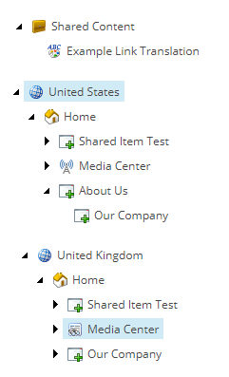
Sharing content between Sites
Best practice:
Shared Content should be stored outside of any one site's content tree structure.
https://byteium.com/2019/08/content-sharing-and-links-in-sitecore

Slide 22
Static vs Dynamic Placeholder
main
main
heading
heading
navigation
navigation
Body-2-col
Body-2-col
left
right
left
right
Banner
News
Banner
News
Body-2-col-second
Body-2-col
left
right
left
right
Rating
Testimonial
Rating
Testimonial

Slide 23
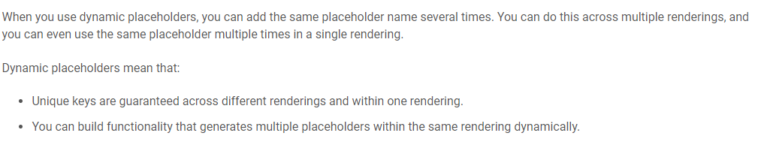
Dynamic Placeholder
Dynamic placeholders: Same key but unique content
https://doc.sitecore.com/xp/en/developers/92/sitecore-experience-manager/dynamic-placeholders.html
https://sitecorediaries.org/2019/12/04/what-is-layout-in-sitecore-and-how-can-we-create-it/#:~:text=Layouts%20are%20the%20scaffolding%20for,one%20can%20plug%20component%20renderings.
https://sitecorediaries.org/2019/12/09/sitecore-dynamic-placeholders/

Slide 24
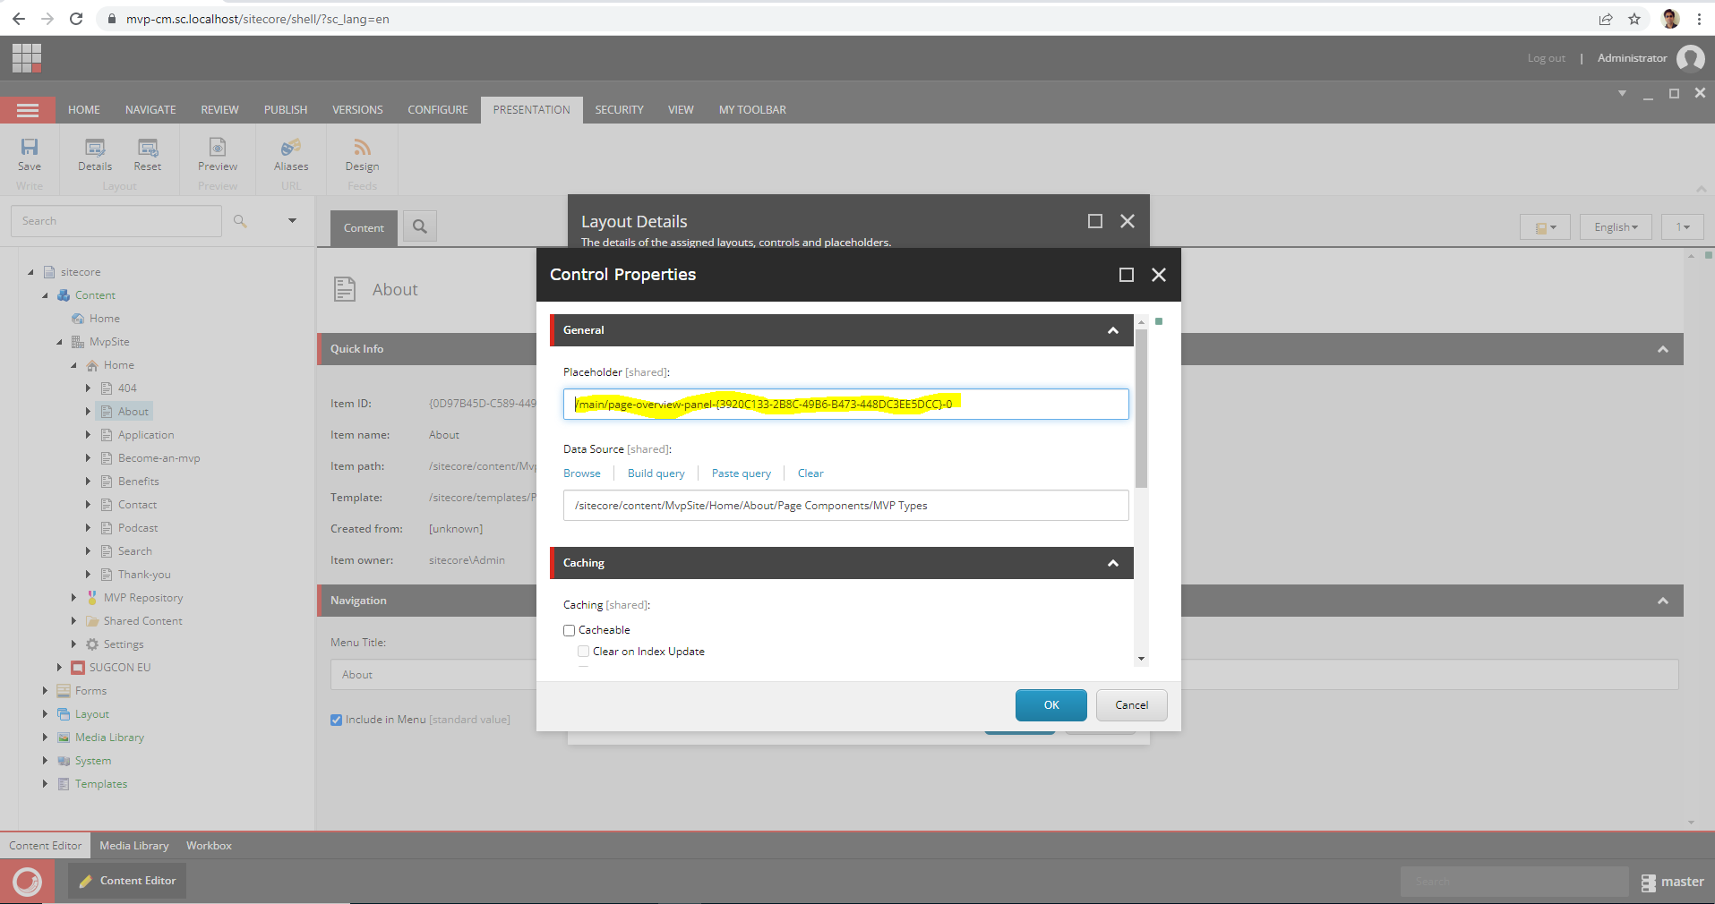
Dynamic Placeholder

Slide 25
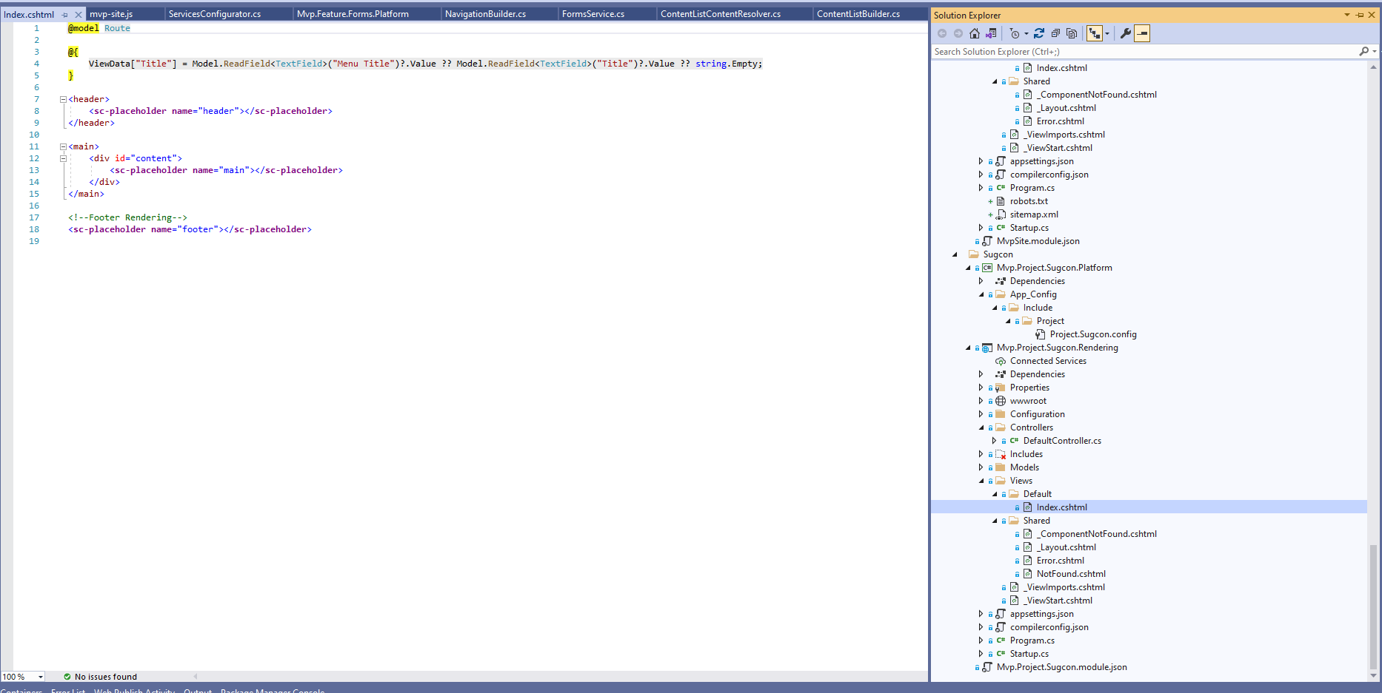
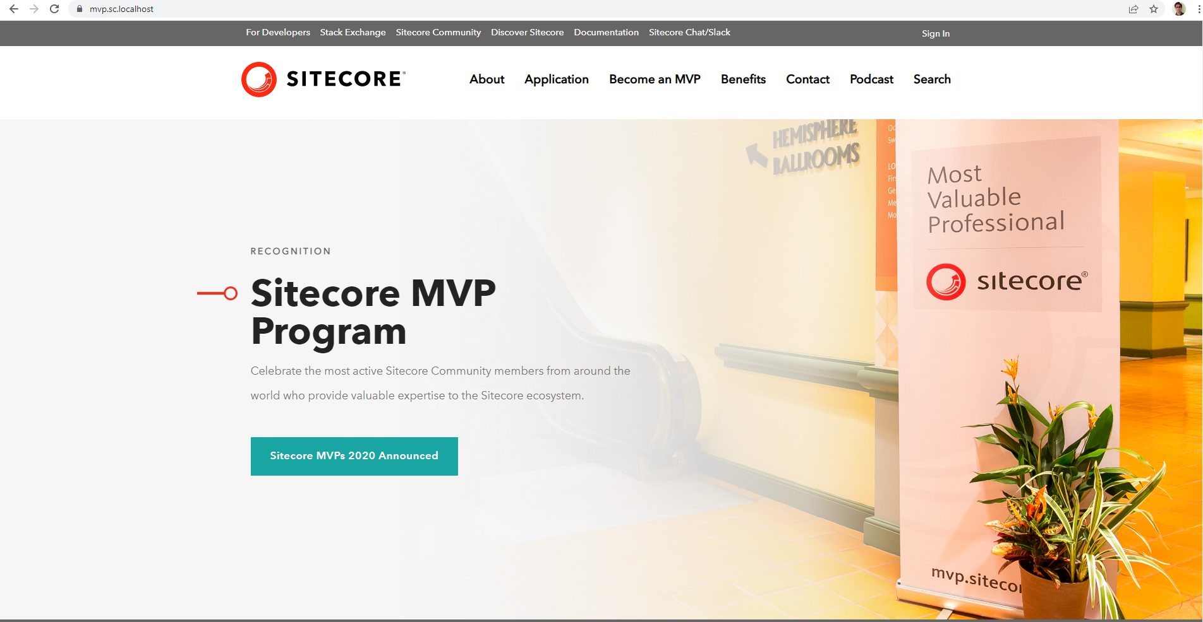
Visual Studio Publish
Code Publish
C:\Source Code
C:\inetpub\wwwroot\<deploy folder>
Note: Code publish different from Content editor publish! Also, remember that you can manually copy cshtml files from your solution to the web root folder
Tip: While writing C# code, Sitecore.Context is utilised to get Http request details

Slide 26
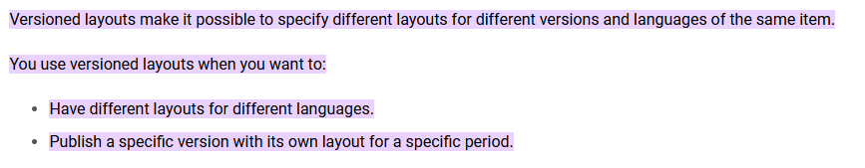
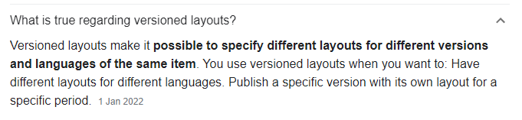
Versioned Layouts
https://doc.sitecore.com/xp/en/developers/93/sitecore-experience-manager/versioned-layouts.html#:~:text=Versioned%20layouts%20make%20it%20possible,layout%20for%20a%20specific%20period.

Slide 27
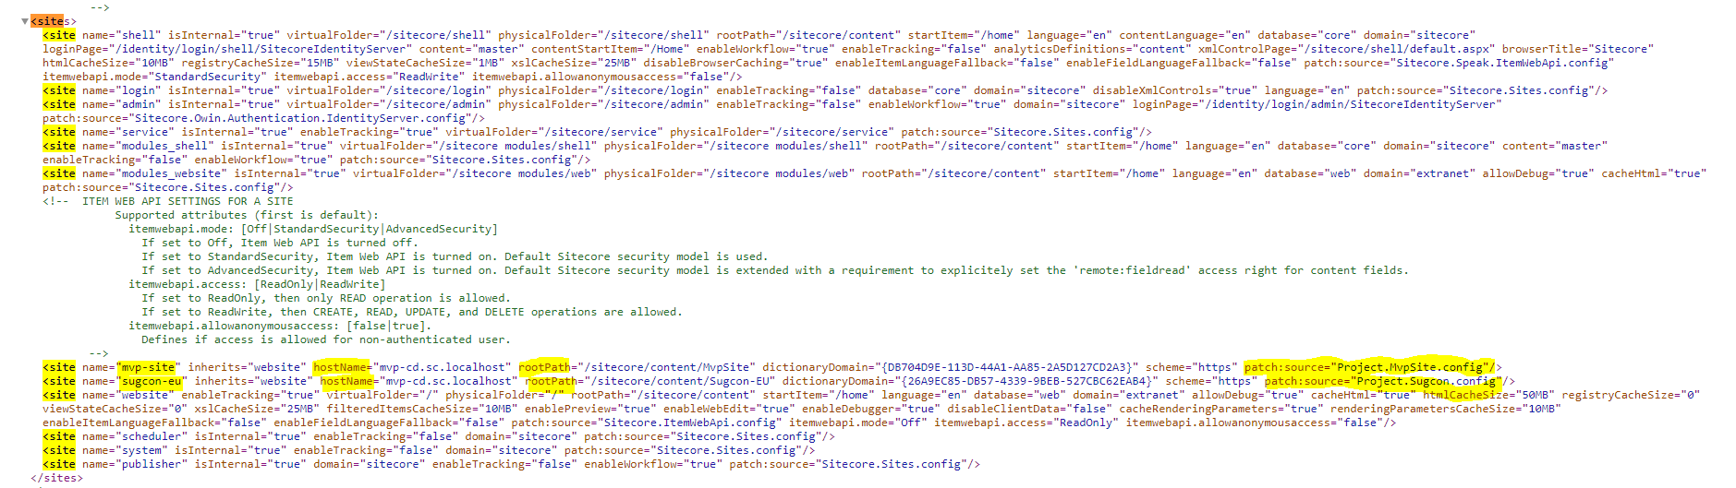
Site Definition Patch Config
Patch file is used to accommodate multiple public-facing sites and used to map home item to corresponding hostname

Slide 28
Config Files Load Order
Modules Layer
Sitecore Layer
Basic System Files
Environment Layer
Custom Layer

Slide 29
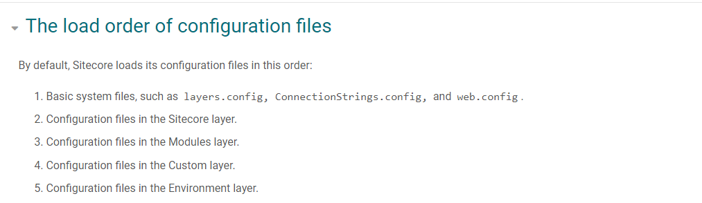
Layers/Load Order
https://doc.sitecore.com/xp/en/developers/92/platform-administration-and-architecture/configuration-layers.html

Slide 30
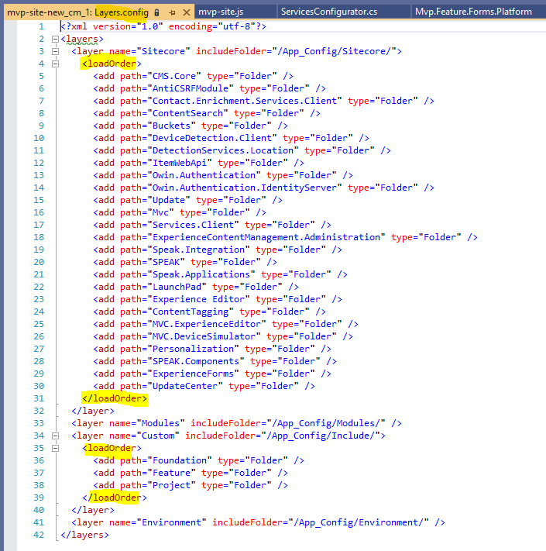
Layers Config File

Slide 31
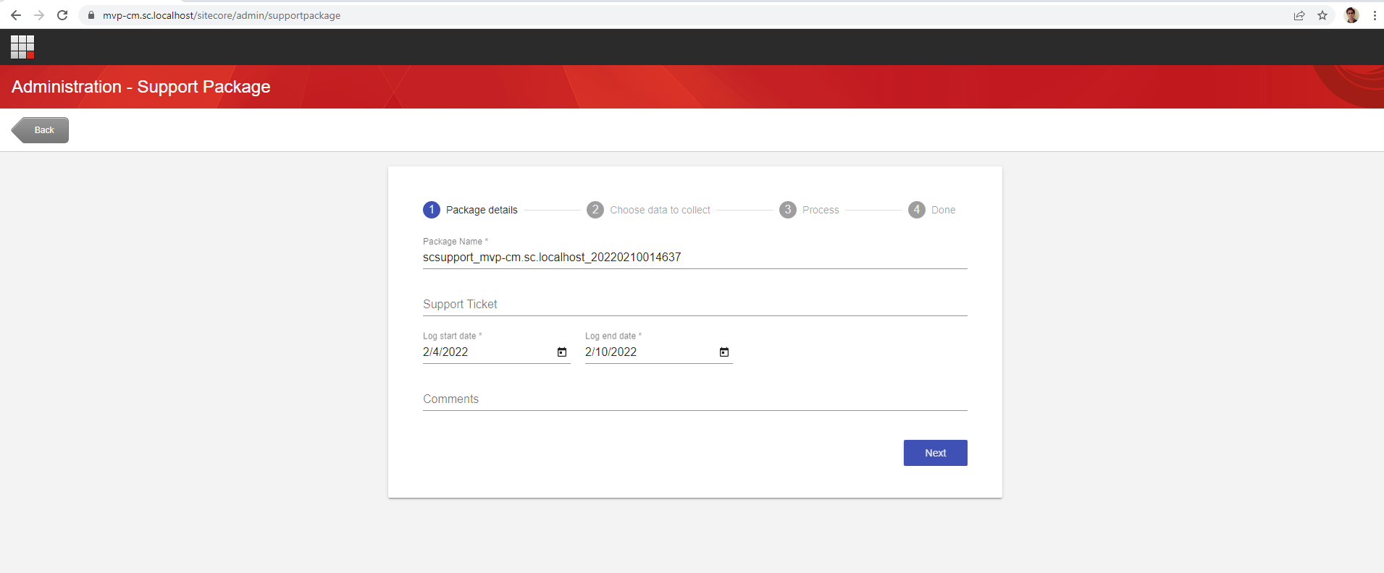
Sitecore Support Package
Purpose: Help Sitecore team replicate an issue without accessing the actual Sitecore environment

Slide 32
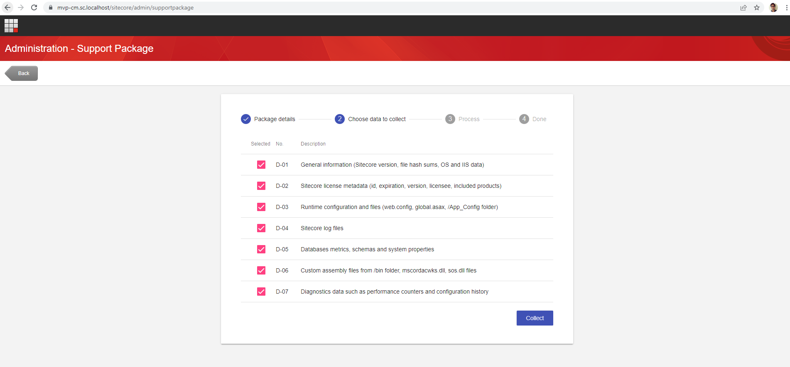
Sitecore Support Package
https://support.sitecore.com/kb?id=kb_article_view&sysparm_article=KB0406145

Slide 33
Sitecore Security Domains
Domains
Extranet
Sitecore
Default
https://doc.sitecore.com/xp/en/developers/93/platform-administration-and-architecture/security-domains.html#:~:text=Sitecore%20is%20setup%20with%20Extranet,are%20set%20to%20default%5Canonymous.

Slide 34
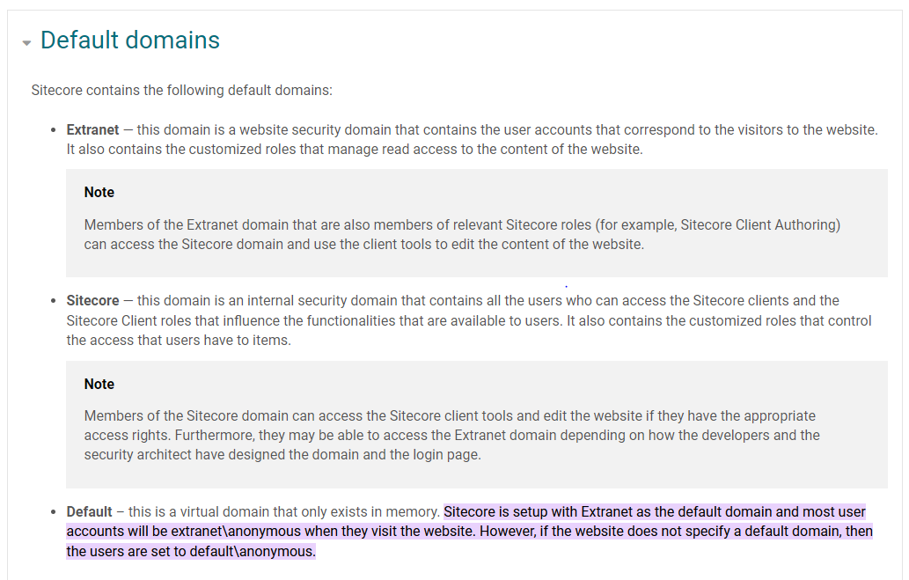
Sitecore Security Domains
https://doc.sitecore.com/xp/en/developers/93/platform-administration-and-architecture/security-domains.html#:~:text=Sitecore%20is%20setup%20with%20Extranet,are%20set%20to%20default%5Canonymous.

Slide 35
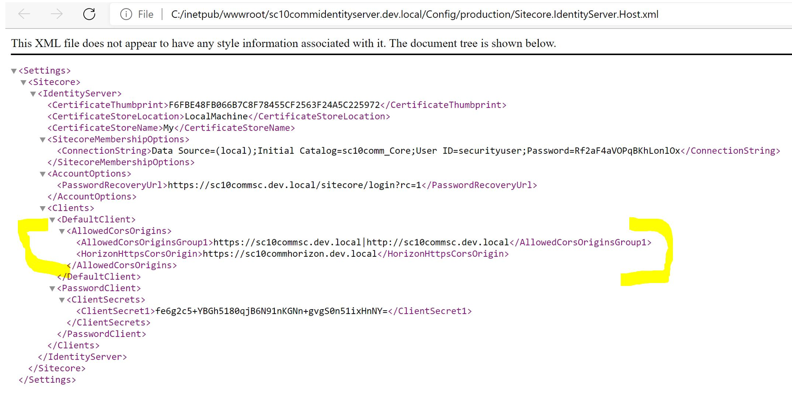
Allowed CORS Origin
I
D
S
E
R
V
E
R
Authenticated
https://sc10commsc.dev.local
https://sc10commhorizon.dev.local
Authenticated
https://sc10identityserver.dev.local

Slide 36
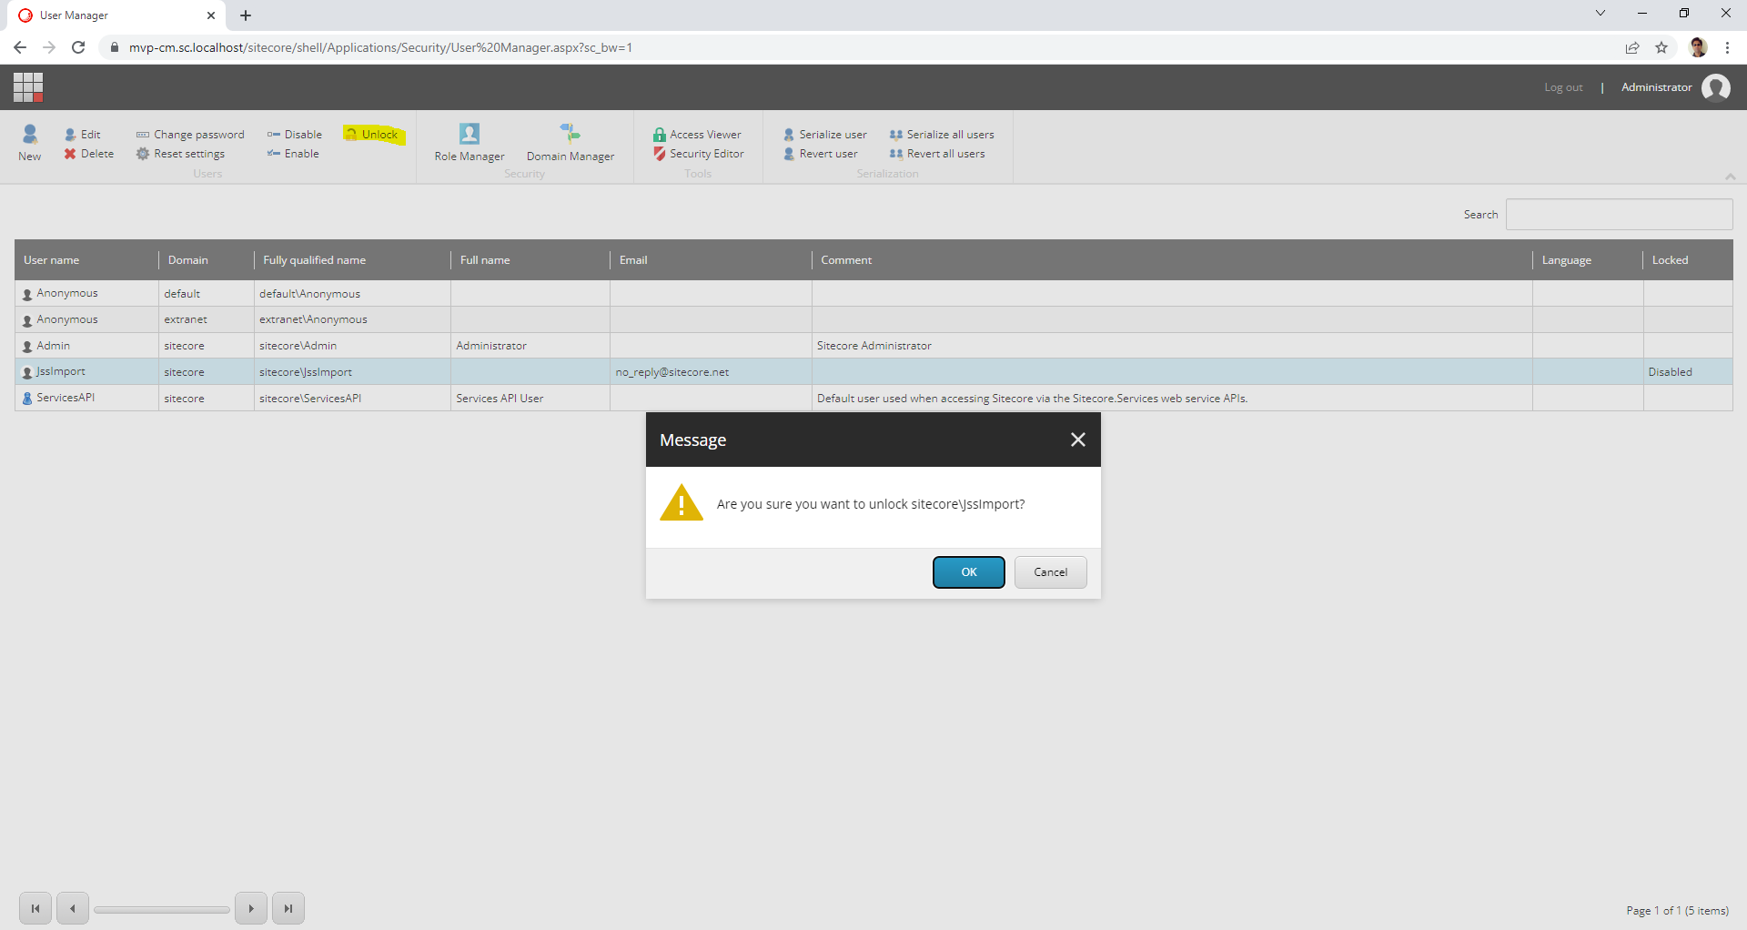
User Manager
Familiarise with user options below -

Slide 37
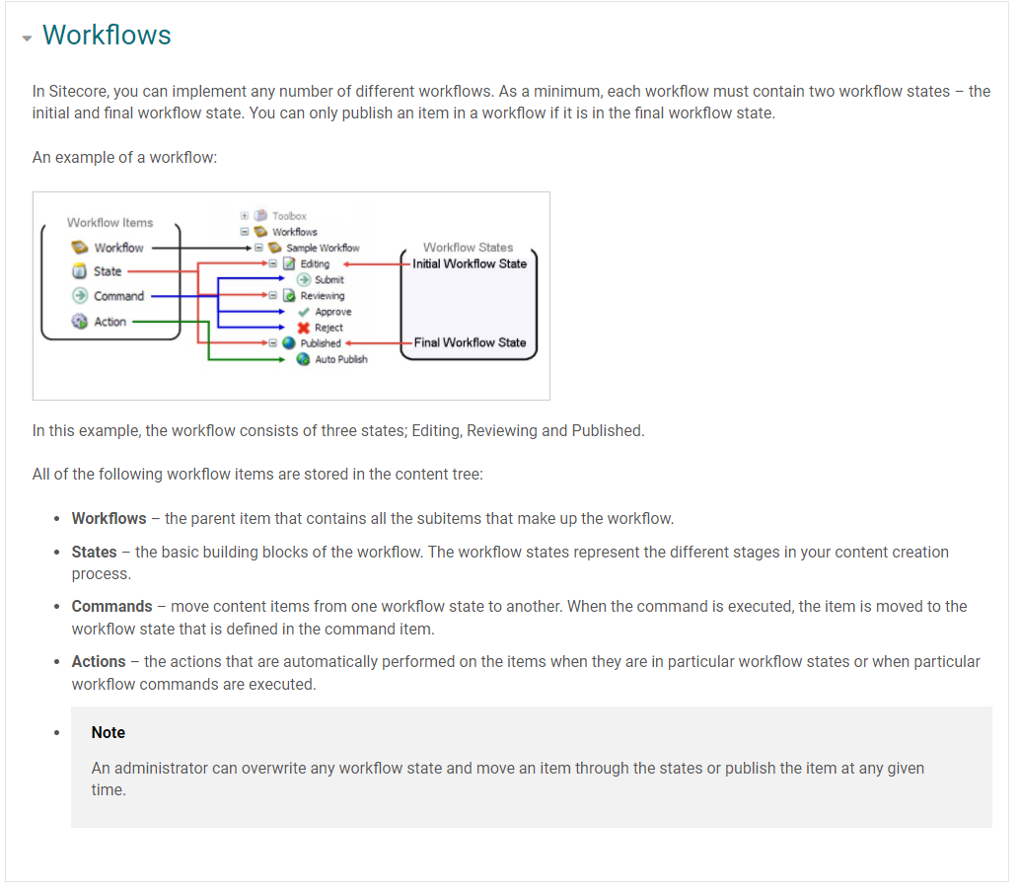
Workflow
Workflow Commands:
Content Editor
Experience Editor
Workbox

Slide 38
Elements of a Workflow
Workflow
States
Commands
Actions

Slide 39
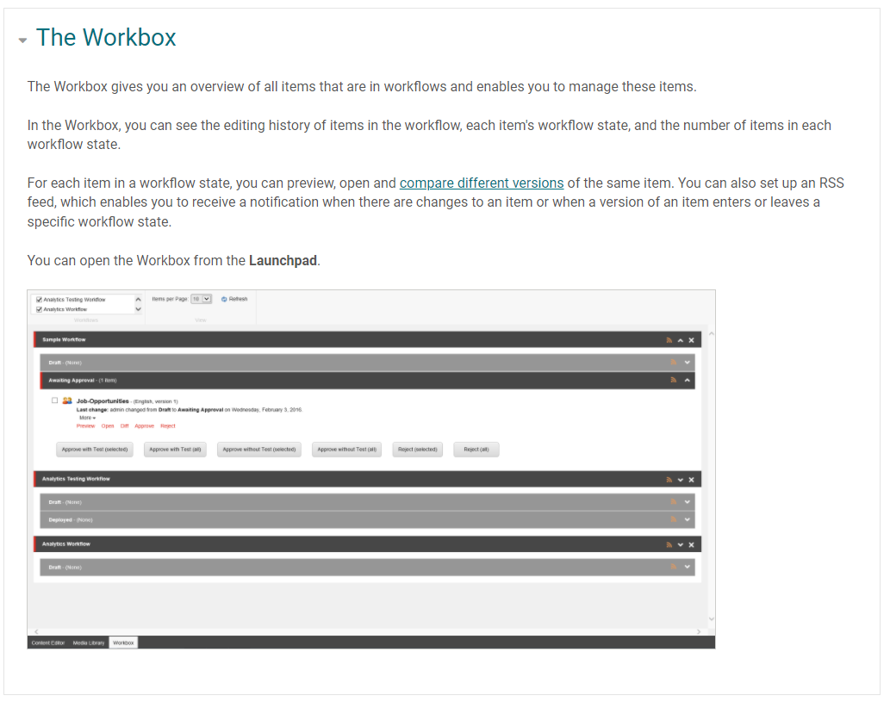
Sitecore Workbox
https://doc.sitecore.com/xp/en/users/93/sitecore-experience-platform/workflows-and-the-workbox.html

Slide 40
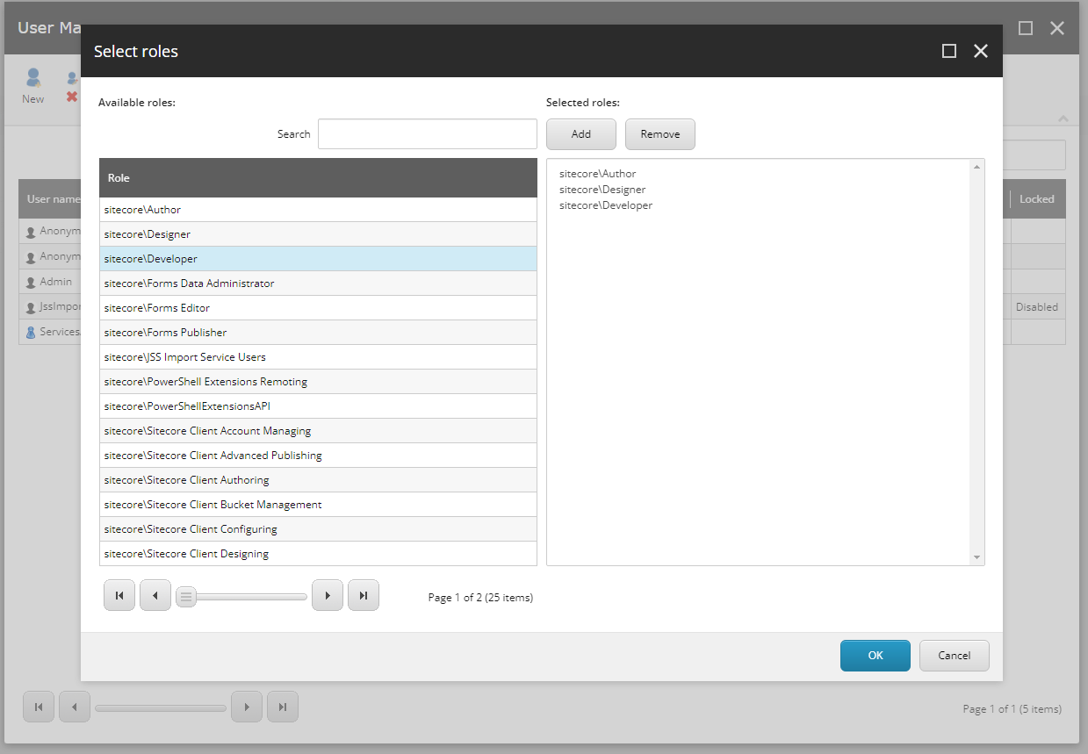
Users/Groups - Security

Slide 41
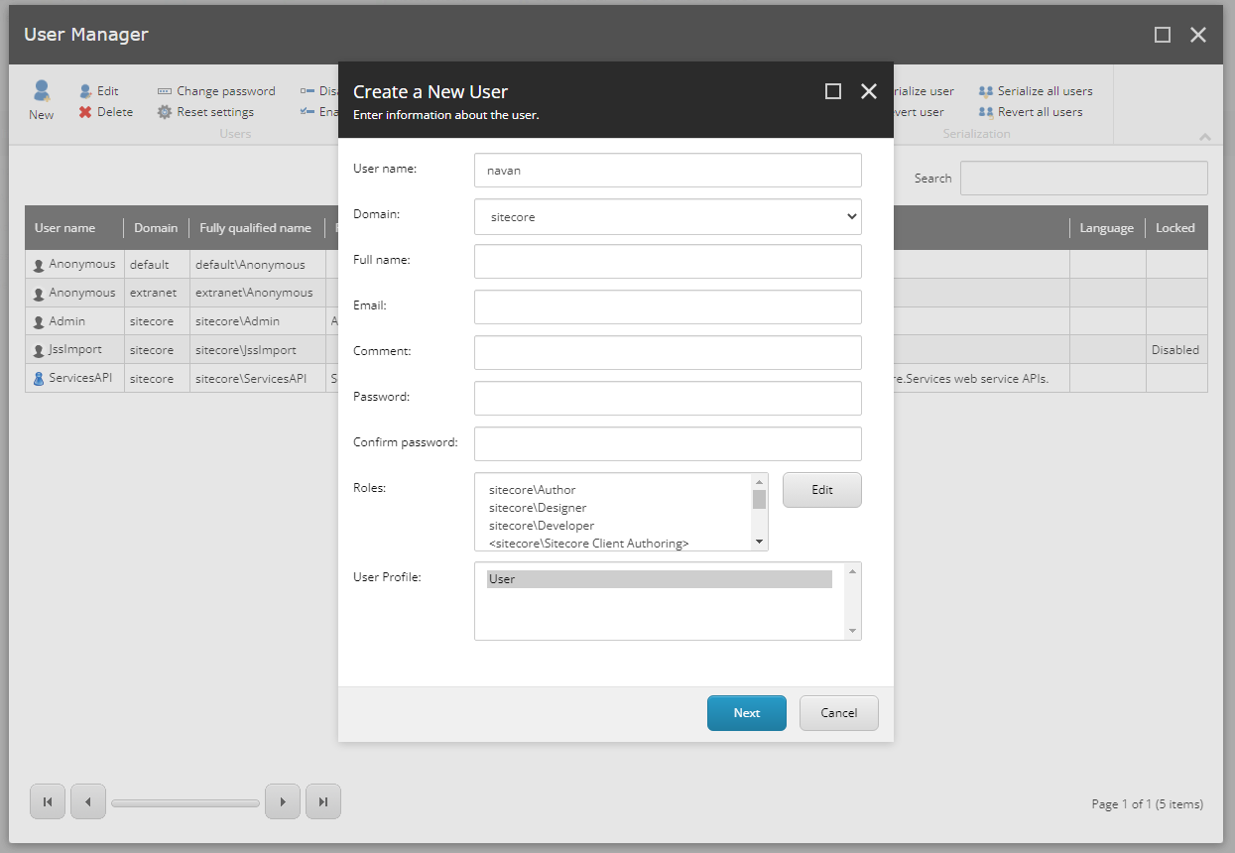
Users/Groups - Security
Can edit roles for a user

Slide 42
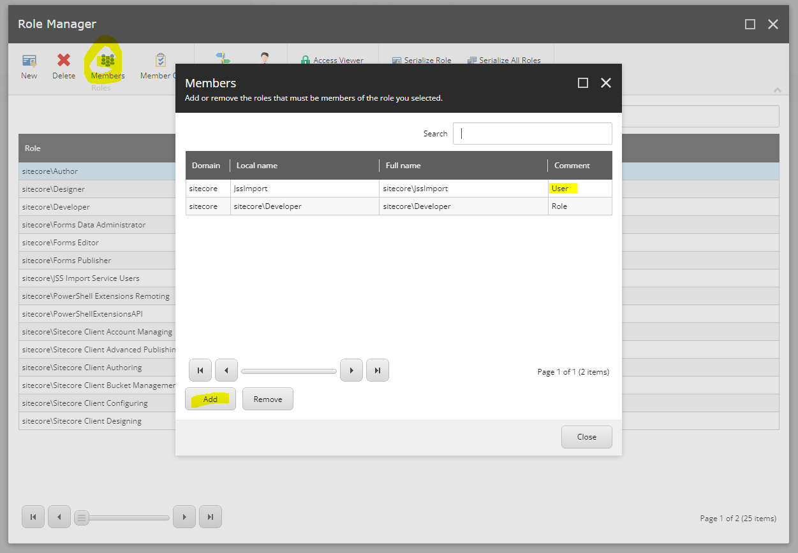
Role Manager
Can add users as members of a role

Slide 43





Users/Groups - Security
Permission-1
Role-1
Members
Permission-2
Permission-3
Role-2
Members
Permission-4
Permission-5
Role-3
Members
Permission-6

Slide 44
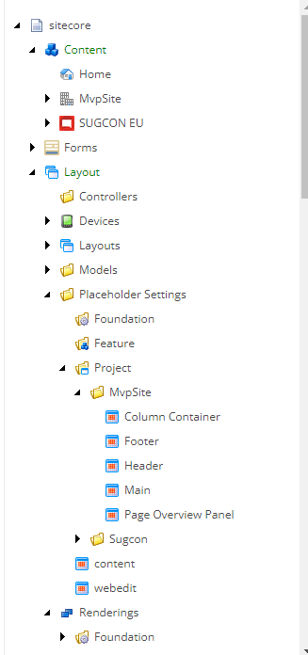

Sitecore ASP.NET Core Rendering Host
Headless Services
RENDER
IN
G
HOST
ASP.NET Core Rendering SDK
Layout Service Client
Rendering Engine
CM
CD

Slide 45
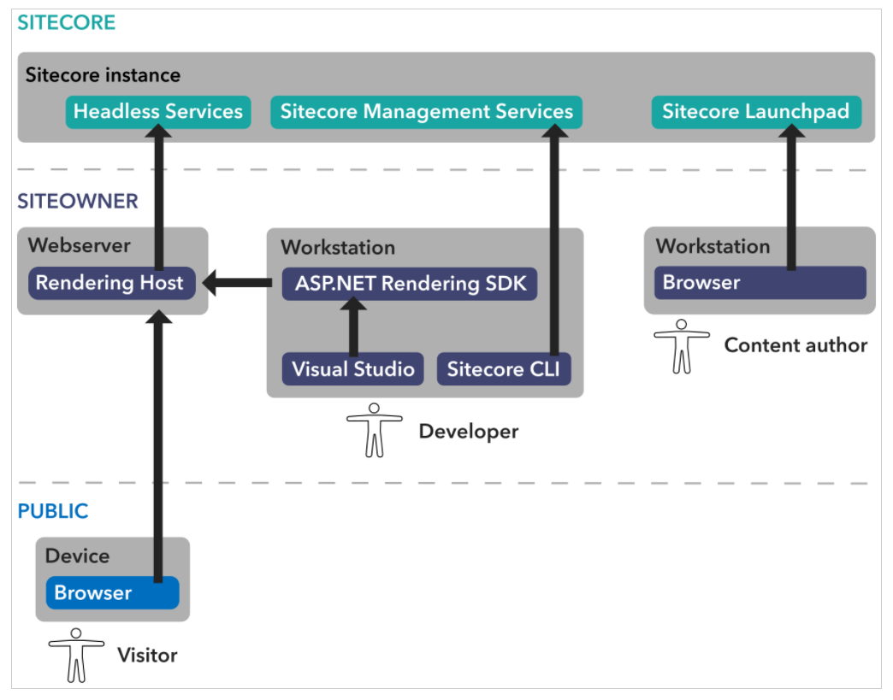
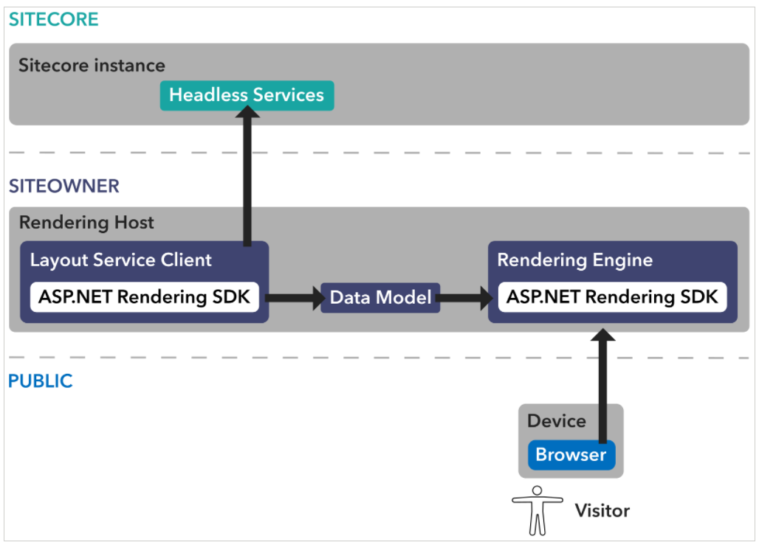
Sitecore Headless Service
https://doc.sitecore.com/xp/en/developers/100/developer-tools/sitecore-headless-development-conceptual-overview.html

Slide 46
Sitecore ASP.NET Core Application Layers
Shared Model
Any shared logic
Shared
(.Net Standard)
Sitecore Pipeline Processor
Sitecore Layout Service Resolver
Any kind of patching logic
Schema Extender
Service / Application Logic
References Sitecore Layout Service
Platform
(.NET 4.8)
Controller logic means APIs can be exposed
References other .NET core projects
As the name goes, views fall here
References Sitecore Layout Service Client
Cross-cutting calls must be through APIs as per headless principles
Rendering
(.Net Core App)

Slide 47
Sitecore ASP.NET Core Application Design
Social
Shared
(.Net Standard)
Forms
BasicContent
Navigation
BasicContent
People
User
Platform
(.NET 4.8)
MVP Site
Forms
Social
Sitecore Extensions
Navigation
BasicContent
People
Rendering
(.Net Core App)
MVP Site
Forms
Social
User
Project
Feature
Foundation

Slide 48

Sitecore ASP.NET Core Application Features
Feature
Independent, render Sitecore Content
De-coupled
Light-weight
Consumes Sitecore Layout Service
Preview Code Changes

Slide 49
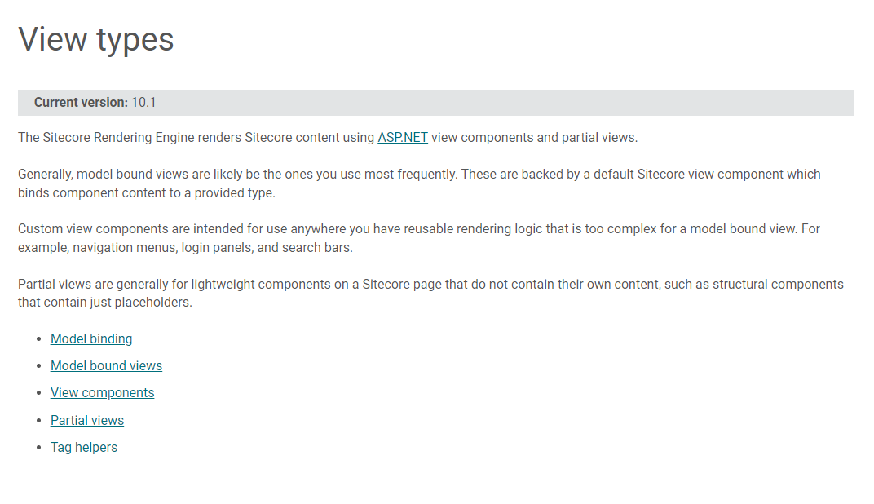
Sitecore ASP.NET Rendering SDK

Slide 50
Sitecore ASP.NET Rendering View Types
Model-bound View | Custom View | Partial View
Most-commonly used | Reusable | Structural
View backed by a model | Complex logic | Light-weight
 | Navigation menus Login panels Search bar | Placeholders

Slide 51
Startup.cs Functionality
Register the Sitecore Layout Service Client invoked by the Sitecore Rendering Engine.
Register the Sitecore Rendering Engine services.
Map a Sitecore rendering component name to an implementation
Forwarding of Scheme as X-Forwarded-Proto to the Layout Service
Enable support for the Experience Editor
Standard ASP.NET Core routing and static file support

Slide 52
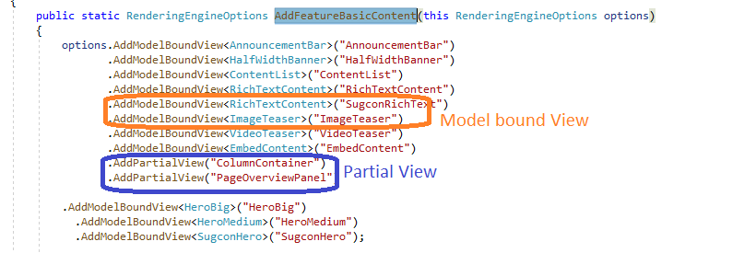
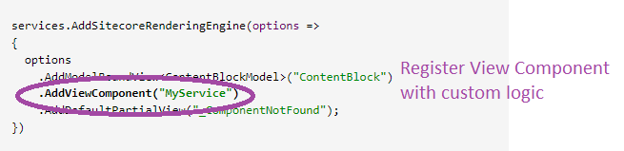
Service registration in Startup.cs
Model-bound View and Partial View Component:
Custom View Component:
https://doc.sitecore.com/xp/en/developers/100/developer-tools/walkthrough--creating-a-view-component-with-custom-logic.html

Slide 53
Sitecore CLI Plugin Setup
Dotnet new tool-manifest
Create .config\dotnet-tools.json
Dotnet local tool manifest file created
dotnet tool install Sitecore.CLI --add-source https://sitecore.myget.org/F/sc-packages/api/v3/index.json
Update CLI version in .config\dotnet-tools.json
Tool 'sitecore.cli' was successfully installed.
Dotnet sitecore init
Create schemas and sitecore.json
Plugin Helper couldn't find configuration file
dotnet sitecore plugin add -n <plugin name>
Download NuGet package to package_cache sub-folder
Successfully installed version <Ver no.> of plugin <plugin name>
User
PowerShell
File System

Slide 54
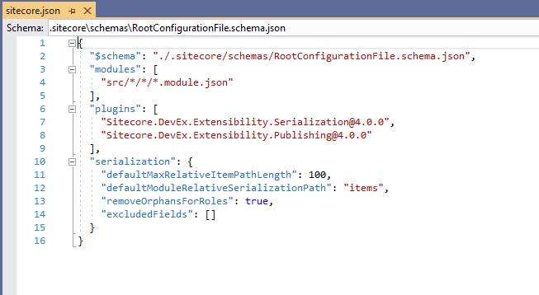
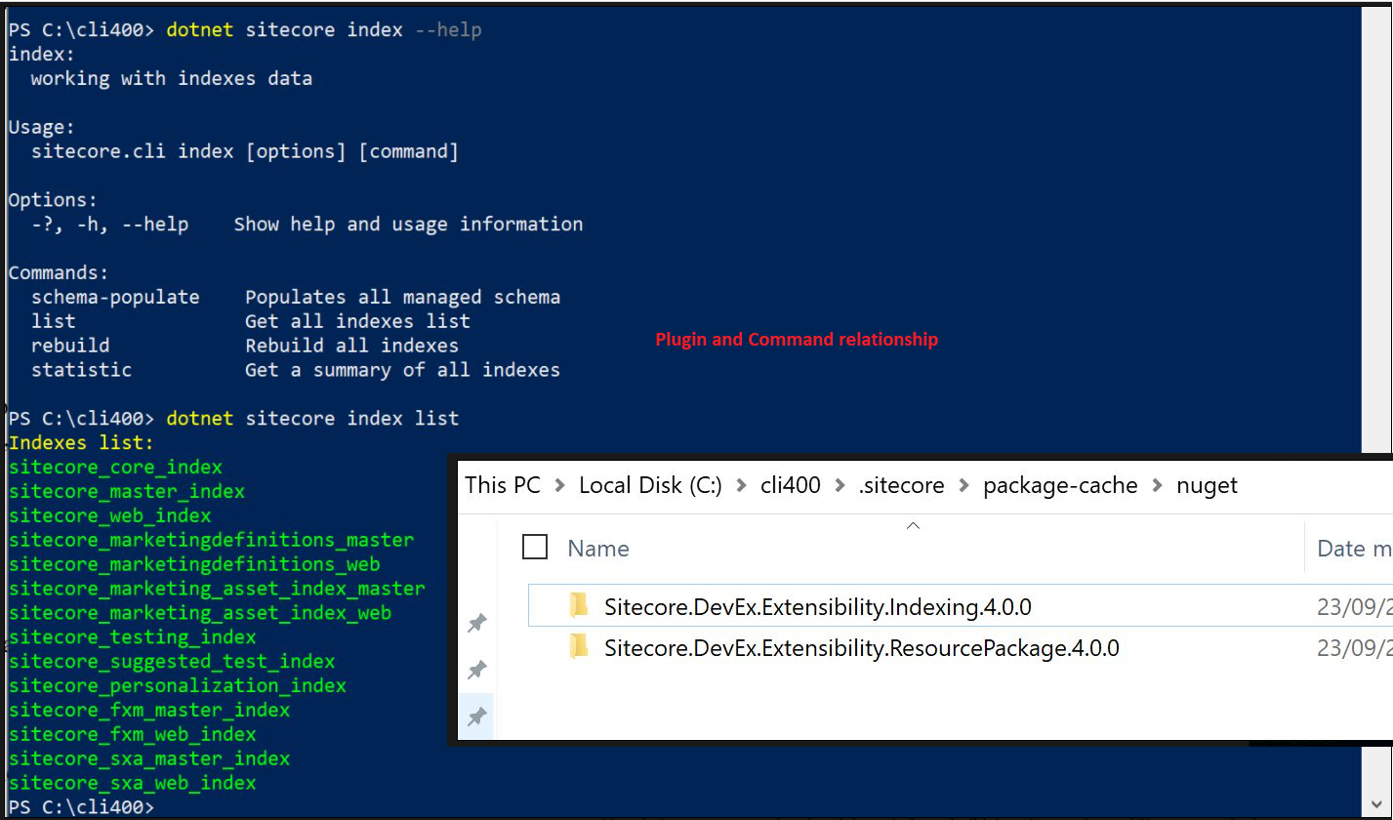
Sitecore CLI – sitecore.json
Specifies what CLI plugins were installed
If plugins are not installed, commands would not be available
The modules section specifies location of json files having serialization information
If the module.json path is not specified here, serialization will not happen

Slide 55
Sitecore CLI – module.json
- The module.json should be added to all folders where serialization must take place
The module.json has item includes that specifies what path must be serialized from the Sitecore tree
If no module.json is present in a folder or content tree path is not specified in module.json the concerned path is not serialized
Dotnet sitecore ser pull used to serialize items to file system
Dotnet sitecore ser push used to deserialize items from file system to Sitecore

Slide 56
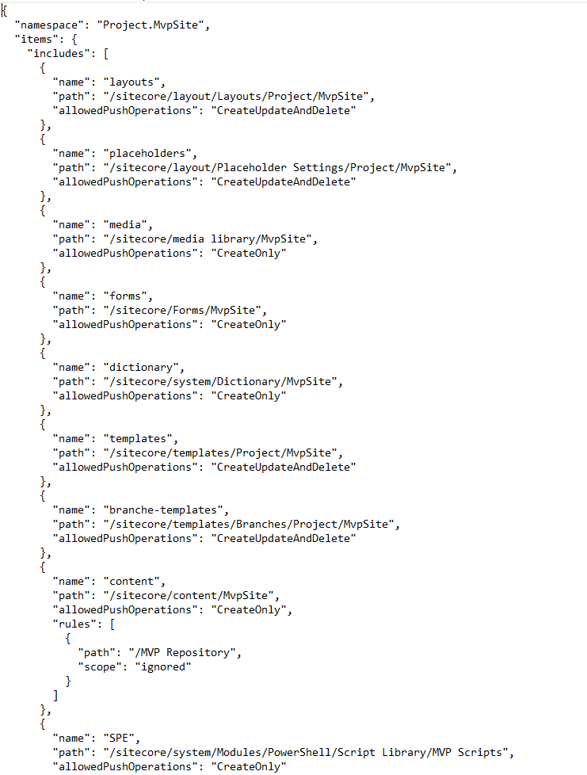
Sitecore CLI – module.json
Structure:

Slide 57
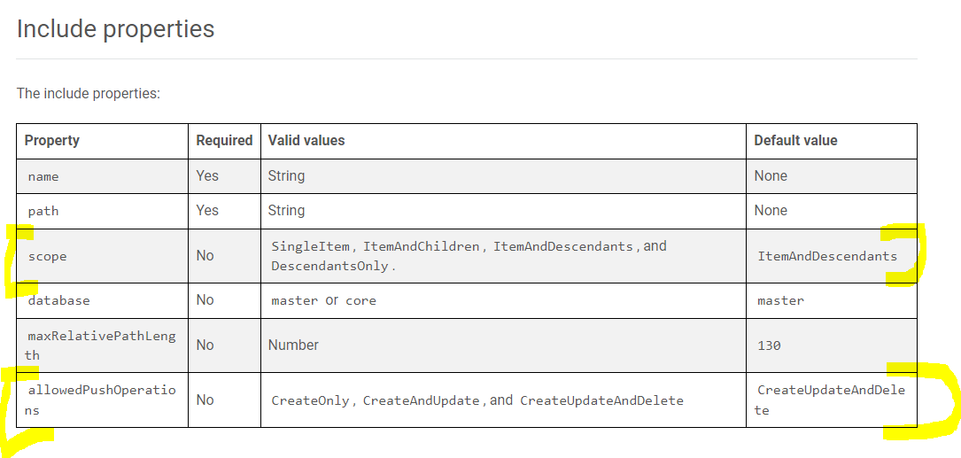
Sitecore CLI – module.json
https://doc.sitecore.com/xp/en/developers/101/developer-tools/sitecore-content-serialization-configuration-reference.html

Slide 58
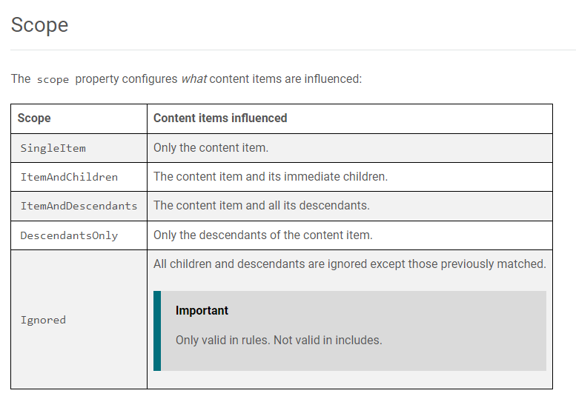
Sitecore CLI – module.json

Slide 59
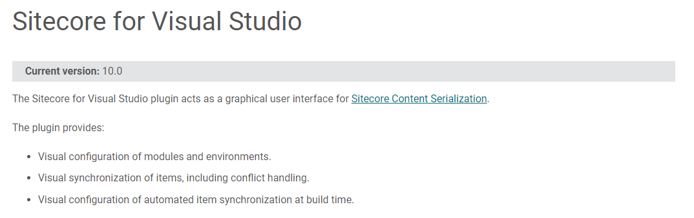
Sitecore CLI vs Sitecore for Visual Studio
Both tools are created by Sitecore and compatible with one another
Although Sitecore for Visual Studio is licensed
https://doc.sitecore.com/xp/en/developers/100/developer-tools/sitecore-for-visual-studio.html

Slide 60
Sitecore Docker Lifecycle
The below flow describes general lifecycle of Sitecore Docker Container(s)
Fill Variable Values
.env file
Docker-compose.yml
Docker-compose up -d
Displays log
Docker-compose logs –f <container name>
Containers up and running
Docker-compose down
Containers Stopped
Tip: From Sitecore 10, Sitecore Container Registry provides base container images for production and development environments

Slide 61
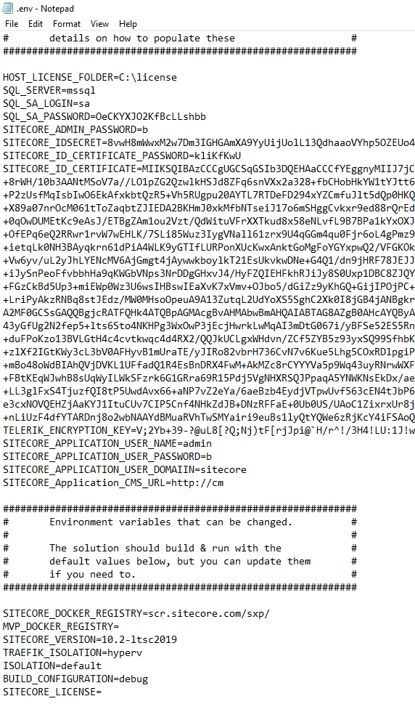
.env file
The HOST_LICENSE_FOLDER stores the location of license file while SITECORE_LICENSE variable stores the compressed license value
If you receive a conversion error as part of compressing the license file (as below) then use HOST_LICENSE_FOLDER
Unhandled Exception: System.FormatException: The input is not a valid Base-64 string as it contains a non-base 64 character, more than two padding characters, or an illegal character among the padding characters. at System.Convert.FromBase64CharPtr(Char* inputPtr, Int32 inputLength) at System.Convert.FromBase64String(String s)
https://sitecore.stackexchange.com/questions/25991/identity-server-container-fails-to-launch-due-to-license-error-using-headless-ge

Slide 62



Questions & Answers

